Slide 1

CHICAGO CITY CRIME DASHBOARD REPORT
Rajneesh Vashisht
Yamuna Nagar

Slide 2
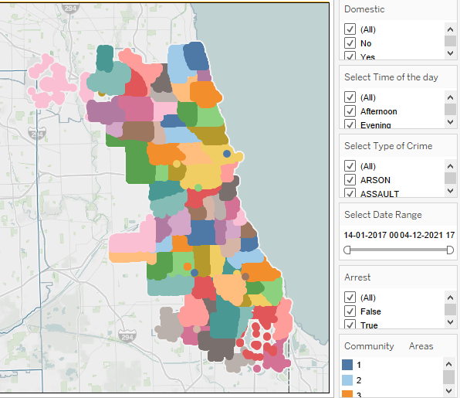
Crime Locations in Chicago City
This plot shows Location of crimes in different neighborhoods of the Chicago city in different colors.
With the help of the filters shown on right side of plot Police department can found at what time of day crime took place, whether it was domestic, its type, date range, whether an arrest was made or not and location of crime.
From the above information one can find pattern in incidents according to location of crimes.

Slide 3
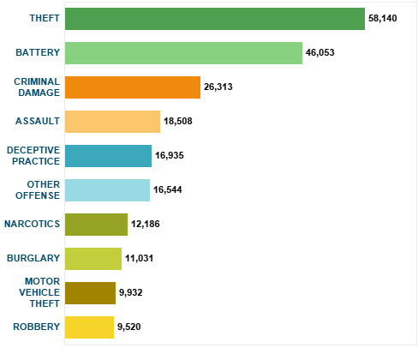
Most Common Crimes
This plot shows count of different types of crimes.
With the help of this plot Police department can found count and types of crimes reported across the city.
Also from this plot it is clear that the most common type of crime is “Theft”.

Slide 4
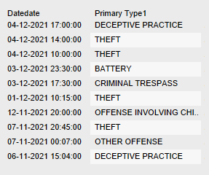

Recent Reported Crimes
This plot shows last 10 crime incidents along with their time of reporting.
Here Also we can see that “Theft Crime” is occurring more frequently than others.
This plot shows total number of crimes reported till date.

Slide 5
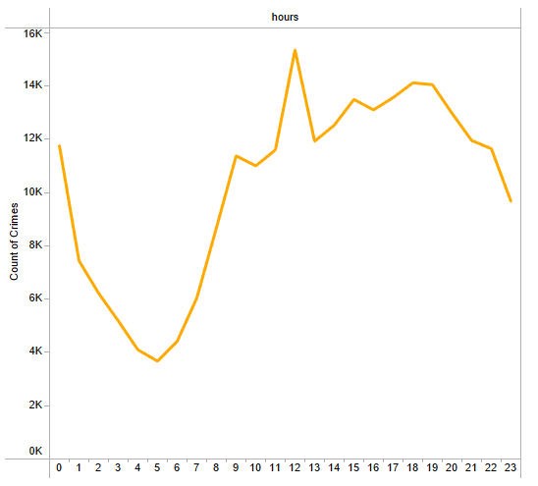
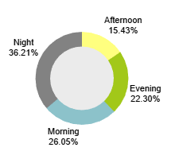
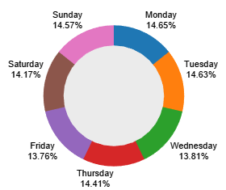
Distribution of Crimes across Day, Week and Hours
This plot shows distributions of crime incidents across days, weeks and hours.
From these plots we can infer that maximum crime takes place at night, no pattern found in crime incidents according to week days and during day hours crime incidents peek at noon.

Slide 6
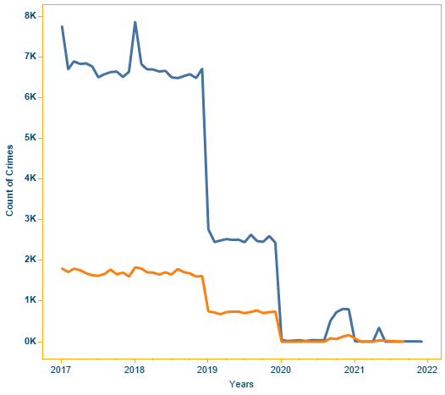
Trend of Crime Incidents along with Years
This plot shows crime trend along with years from 2017 to 2022.
From the plot we can infer that there is significant drop in crime rate after 2019.

Slide 7
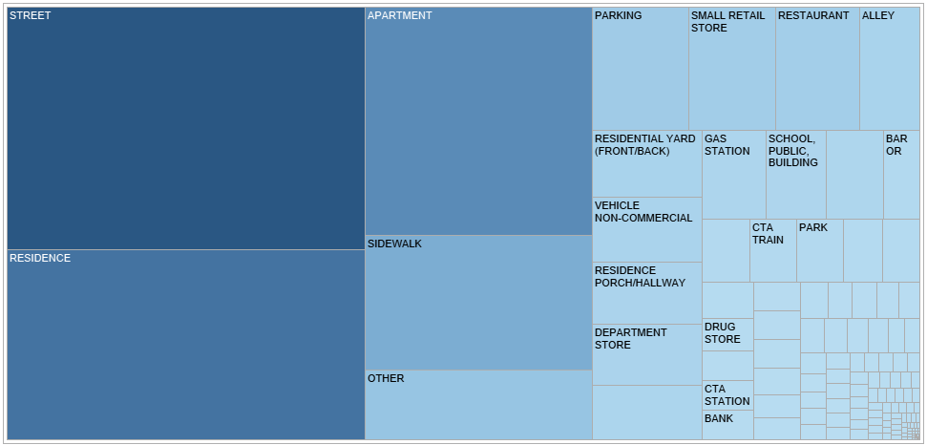
Frequent Crime Locations
This plot shows importance of location in happening of crime.
From the plot we can infer that street and residences are the most vulnerable location for a crime to take place.

Slide 8
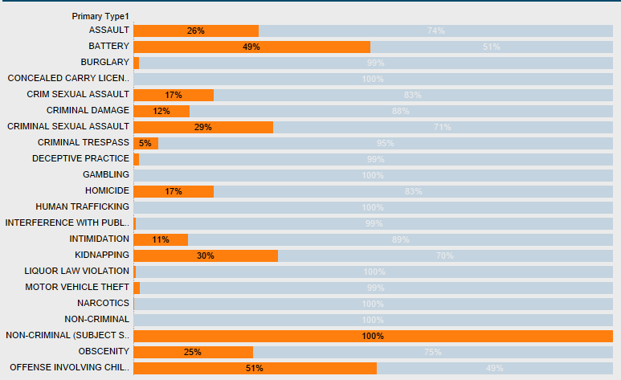
Distribution of Crime According to Domestic
This plot shows distribution of different types of crime according to percentage of cases registered as domestic among them.
From the plot we can infer that “Non Criminal (Subject Specified)” Crime is having very high percentage of domestic in it.

Slide 9
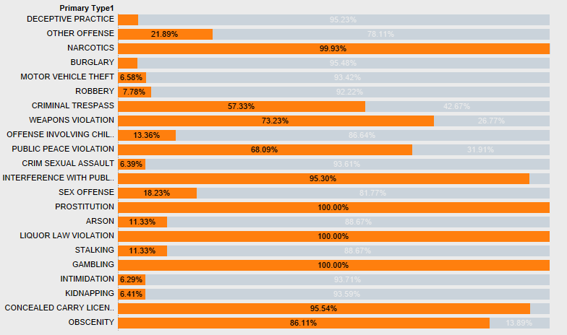
Distribution of Crime According to Arrest
This plot shows distribution of different types of crime according to percentage of suspect arrested or not among them.
From the plot we can infer that there are several Crimes like “Prostitution", "Liquor Law Violation”, “Gambling” etc. which have 100% arrest rate in them.

Slide 10

Kindly find the Dashboard at My Tableau Public Profile at below link:
https://public.tableau.com/app/profile/rajneesh.vashisht/viz/ChicagoCityCrimeDashboard/ChicagoCrimeDashBoard

